Slide 1
Cyclistic Bike-Share Analysis
Understanding How Annual Members and Casual Riders Use Bikes Differently
Samarth Gupta
Tools: SQL, Excel, R, Tableau
Date: 08/12/2025

Slide 2
BUSINESS TASK
Business Task
Identify how annual members and casual riders use Cyclistic bikes differently and provide insights that support marketing strategies to convert casual riders into annual members.
Objective
Deliver data-driven insights and recommendations to help improve membership conversions and increase long-term revenue for Cyclistic.

Slide 3
DATA SOURCES
Data Sources :
12 months of Cyclistic historical trip data (CSV format)
~5–6 million rows of trip-level records
Public data provided by Motivate International (via Google Data Analytics Case Study)
Tools Used :
Excel for initial cleaning
SQL for transformation, validation, and descriptive statistics
R for additional analysis
Tableau for visualization and dashboard creation

Slide 4
DATA CLEANING & PREPARATION
Steps Taken :
Converted and standardized datetime formats
Removed null values, duplicates, and negative ride lengths
Created new fields:
  ride_length (duration of each ride)
  day_of_week
  month_name
  year
Validated data integrity across tools
Merged all 12 months into a single cleaned dataset
Exported aggregated data for analysis and visualization
Outcome :
A clean, consistent dataset ready for descriptive and behavioral analysis.

Slide 5
KEY INSIGHTS
1. Members ride more frequently but for shorter durations
Suggests routine, commute-focused usage.
2. Casual riders mostly ride on weekends
Indicates leisure & tourism-driven behavior.
3. Members ride consistently across all days of the week
Strong indicator of habitual weekday commuting.
4. Casual riders have significantly longer average ride durations
Leisure/tourist behavior leading to exploratory rides.
5. Seasonal patterns show heavy summer usage from casual riders
Membership conversion opportunities peak in warm months.

Slide 6
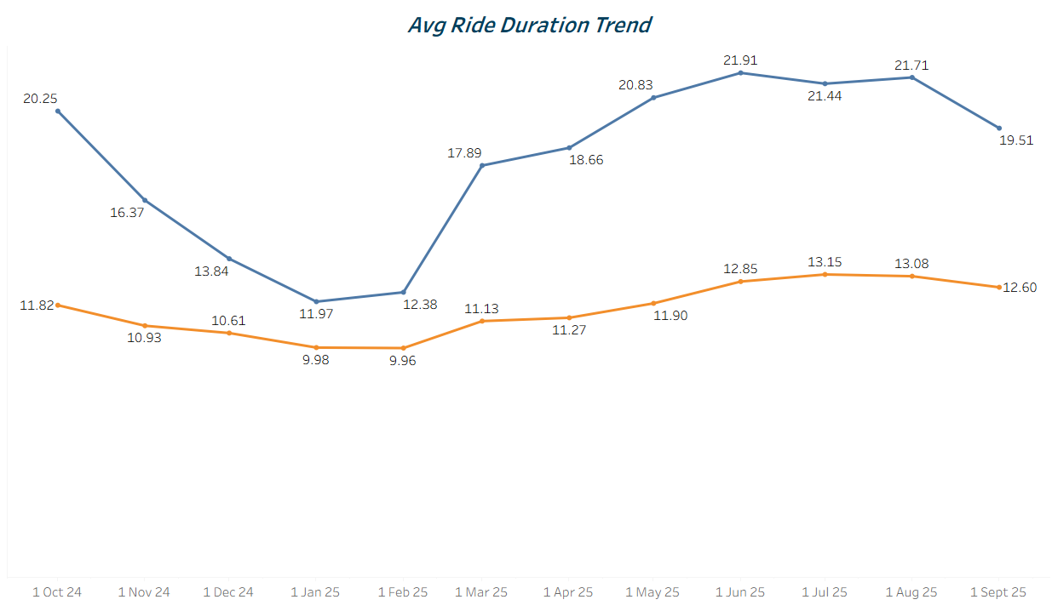
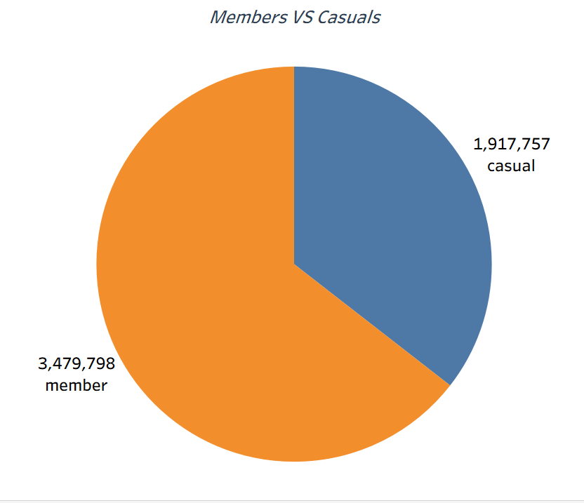
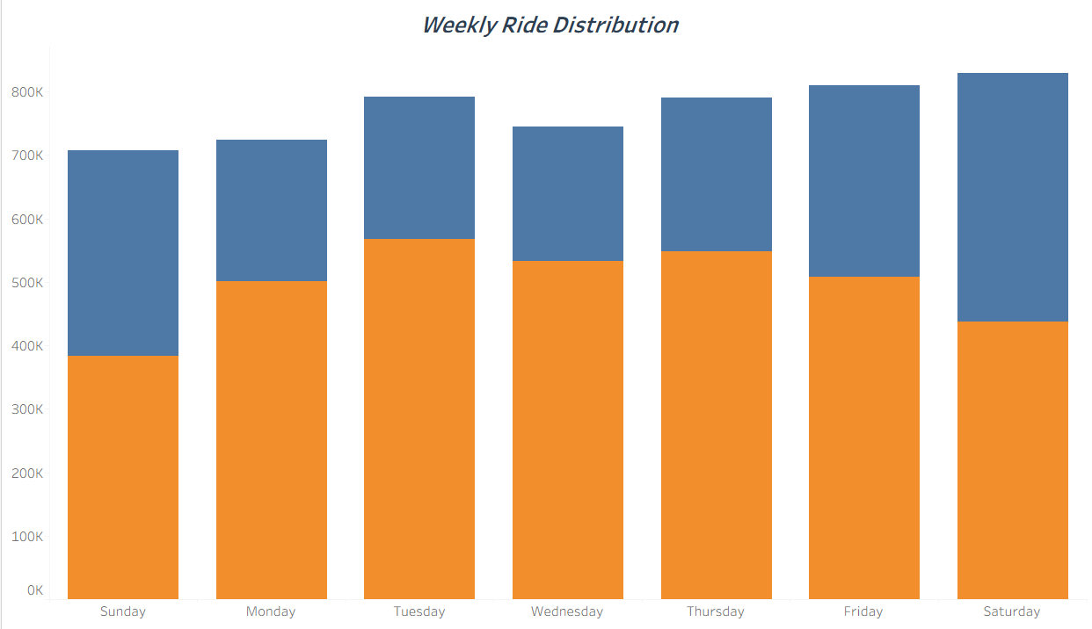
VISUAL HIGHLIGHTS
Avg Ride Duration Trend
Members and casual riders show a clear duration gap, with casual users consistently taking longer rides across all months.
Members vs Casuals (Pie Chart)
Members account for the majority of total rides, highlighting strong recurring usage compared to casual riders.
Weekly Ride Distribution
Members ride more consistently through weekdays, while casual usage peaks on weekends, reflecting leisure-oriented behavior.

Slide 7
INSIGHT SUMMARY
What the Data Tells Us :
Members behave like commuters.
Casual riders behave like tourists or weekend explorers.
Usage behavior is predictable and clearly segmented.
Marketing efforts can be tailored around these patterns to maximize conversions.

Slide 8
Strategic Recommendations
Recommendation 1: Convert High-Value Casual Riders (Weekend Offers)
Insight: Casual usage
peaks on weekends &
summer.
- Strategy :
Launch “Weekend Commuter Lite” trial
passes
Seasonal discounts + instant upgrade QR codes
Outcome: Higher trial-to-membership conversions during peak demand.
Recommendation 2:
Target Tourists & Leisure
Riders (Location-Based Ads)
Insight: Casual ridership clusters around tourist zones.
- Strategy:
Geo-targeted ads (Maps, Instagram, app prompts)
Promote value bundles & upgrade savings
Outcome: Increased acquisition from high-traffic casual segments.
Recommendation 3: Position Membership as the Best Commuter Option
Insight: Members show consistent weekday commuting patterns.
- Strategy:
Cost-saving messaging for repeat casual riders
Introduce “Commute Guarantee” perks (priority docking, early unlocks)
Outcome: More repeat casual riders convert to long-term members.

Slide 9
CONCLUSION
Conclusion :
Cyclistic can significantly improve annual membership conversion by tailoring marketing strategies to distinct rider behaviors.
Deliverables Included :
Cleaned dataset
SQL scripts for analysis
R markdown + R scripts
Tableau dashboard + visual insights
Business recommendations & story presentation
GitHub Repo

Slide 10
CONTACT
Samarth Gupta
gsamarth42@gmail.com | LinkedIn | GitHub

